Slide 1
Industrial and Organizational Psychology Feelings About Work: Job Attitudes and Emotions

Slide 2
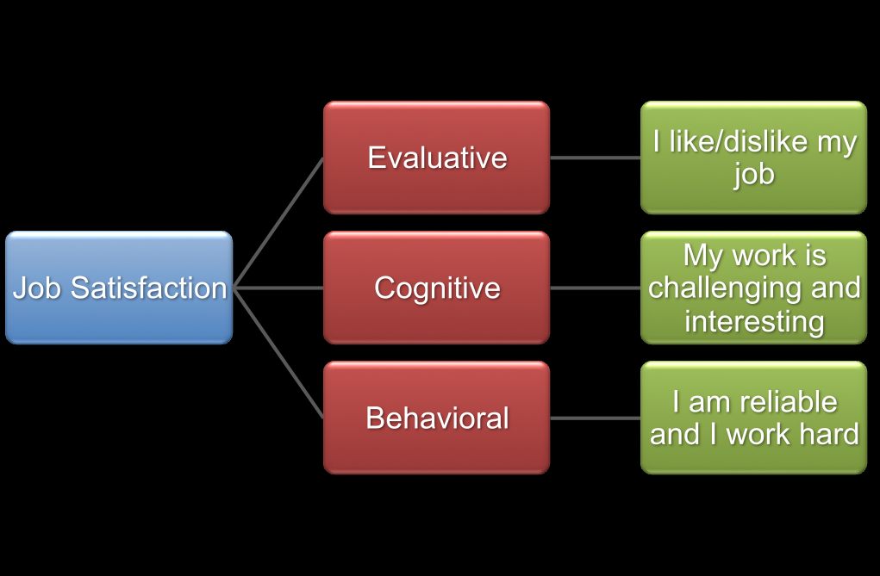

Slide 3
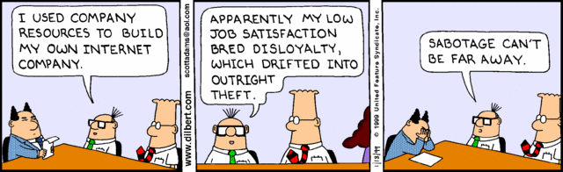

Slide 4
Feelings About Work – Job Attitudes and Emotions
In this chapter we will be discussing employees attitude towards their jobs.
The nature of job satisfaction
How people feel about their Jobs
Assessment of job satisfaction
Antecedents of job satisfaction
Potential effects of job satisfaction
Organizational commitment
Emotions at work

Slide 5
Learning Objectives: Flow of Discussion
Define Job satisfaction and organizational commitment
Differences between Job satisfaction and organizational commitment.
How Job satisfaction and organizational commitment are measured.
Findings on possible effect and causes of Job satisfaction and organizational commitment.
Discuss how emotions are experienced by employees at work and how they impact organizations

Slide 6
Feelings About Work
Job satisfaction: Attitude about the job reflecting like/dislike for it and various facets.
Organizational commitment: Attachment to the job.
Emotion: Reaction to a situation that includes both physiological arousal and cognitive appraisal, e.g., anger or anxiety.

Slide 7
Nature of Job Satisfaction
Job satisfaction is an attitudinal variable that reflects how people feel about their jobs overall and as well as various aspects of jobs
Job satisfaction is extent to which people like their jobs.
Job dissatisfaction is extent to which people dislike their jobs.
Job satisfaction is derived from the difference between what the job rewards and what an employee expects as reward. Thus, a worker’s attitude is directly linked to job satisfaction.

Slide 8
Activity
Form a group of four to six people and list down what do you understand by job satisfaction and what factors contribute/affect to it.
Other group list down factors contributing to job dissatisfaction/ hinder job satisfaction.
One group discuss and list down how do we measure job satisfaction.

Slide 9
Nature of Job Satisfaction: Approaches to study
Global approach: Overall satisfaction with work
Facet approach: Satisfaction with aspects of the job
Pay, Fringe benefits
Promotion opportunities
Supervision and work culture
Nature of work
Coworkers and communication
Job security
Most people like the job overall
Facet satisfactions vary
Highest: Nature of work
Lowest: Pay and Promotion opportunities

Slide 10
Nature of Job Satisfaction
Performance at a workplace can often be directly linked to satisfaction with job.
It is well known fact that the more satisfied an employee feels, greater will be his productivity. Thus, factors affecting satisfaction with job are of prime importance.
Authentic job satisfaction studies for Indian labor market have been limited. One of the main reasons for this has been lack of reliable and sufficient data to draw conclusions.

Slide 11
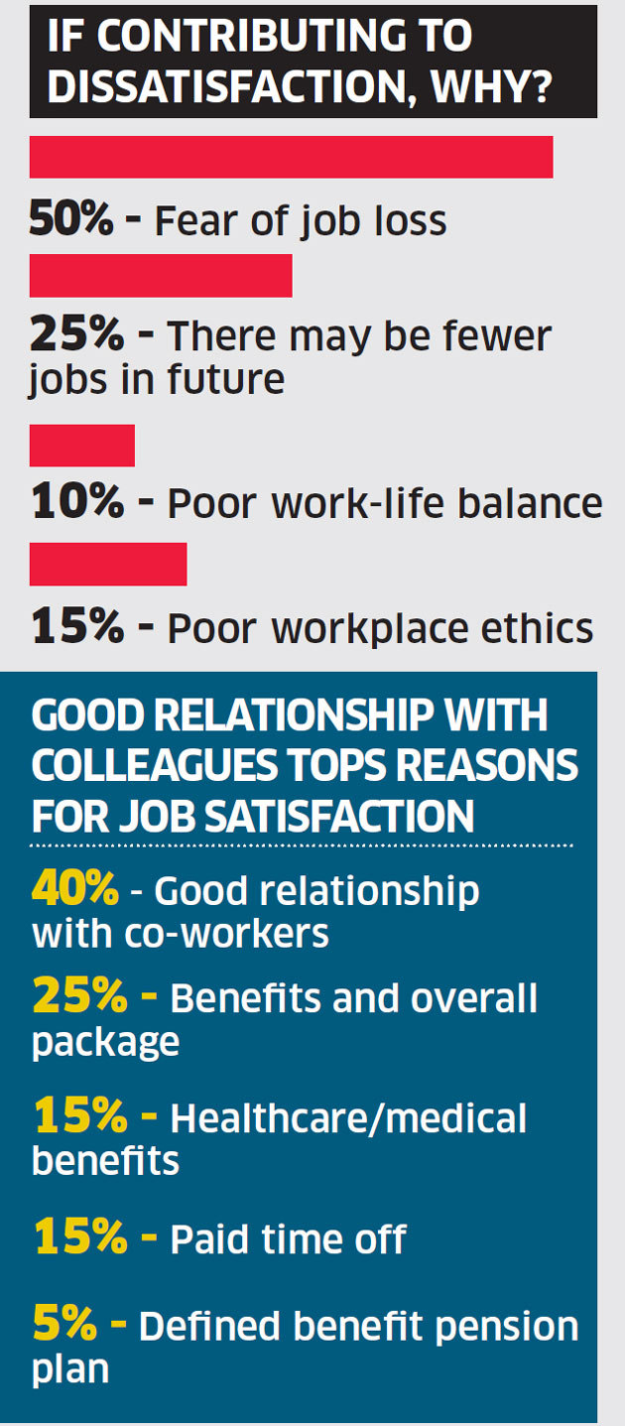
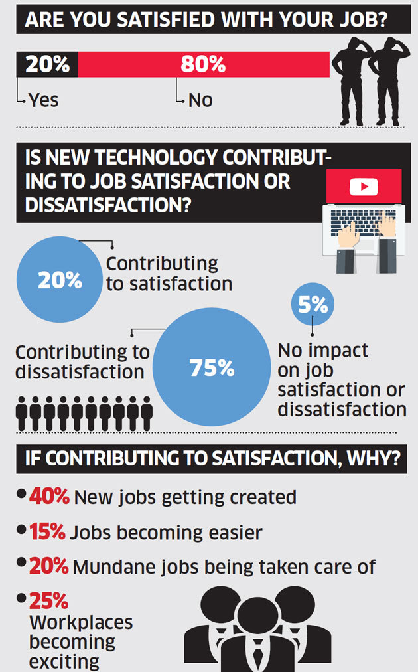
Times Jobs survey of over 1,100 working professionals Eight in 10 employees are dissatisfied with their jobs, and seven in 10 feel that the influx of technology is adding to job dissatisfaction.

Slide 12
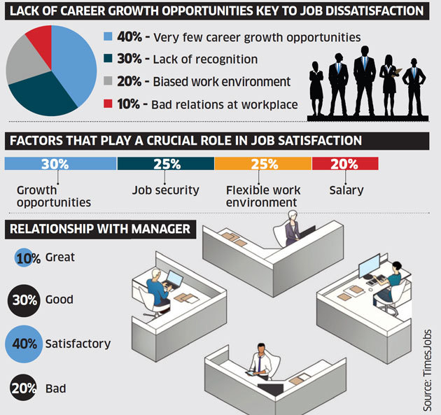

Slide 13
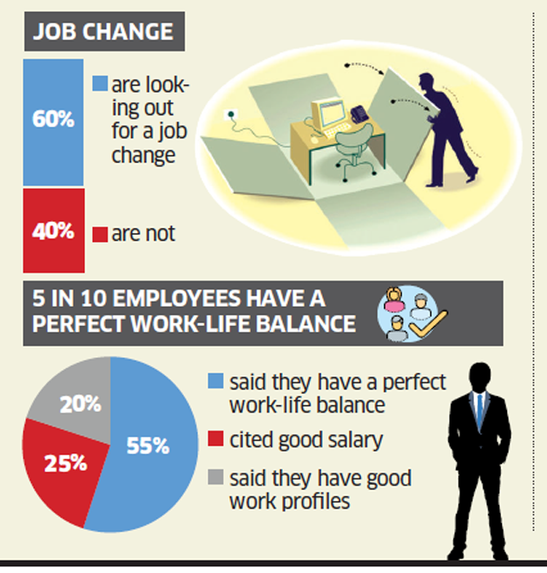
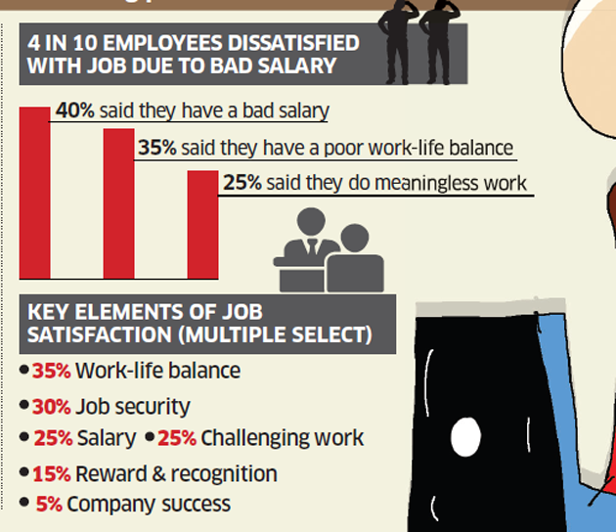
How people feel about their jobs

Slide 14
The job satisfaction factors have been divided into five groups:
Job-related factors: Satisfaction with job, pay, contract and job security
2. Payment factors: Satisfaction with approach to pay, allowances and welfare provisions
3. Relationship factors: Satisfaction with relationship with colleagues, relationship with supervisors and work environment
4. Time factors: Satisfaction with working hours and commuting time
5. Family factors: Satisfaction with family income and combination of work and family

Slide 15
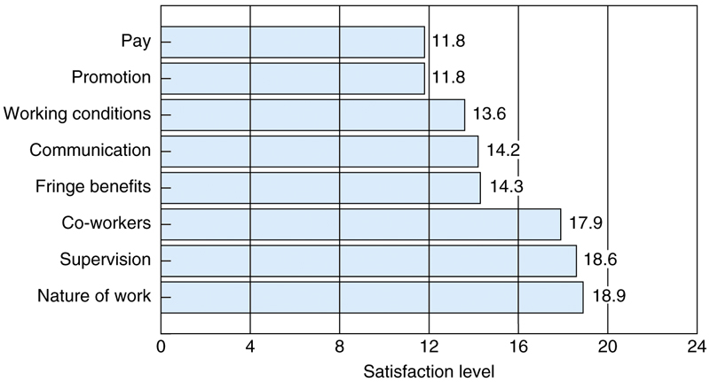
Mean levels of U.S. Satisfaction On the Job Satisfaction Survey (Spector 1985)
JSS is scale that assesses eight popular facets of job satisfaction.
Norms are based on JS scores of 36,3820 employees from more than 100 organization across united states

Slide 16
Cultural values that influence Job satisfaction
Individualism/Collectivism:
Individualism: Autonomous and focus on own interest and needs.(USA, Canada, UK, Australia)
Collectivism: Interconnected and focus on groups.(Asian and Latin)
Masculinity: Focus on achievement and job performance as opposed to health and well being of employees.
Power distance: Tolerance of power and status differences among the managers who demands obedience from subordinates.
Uncertainty avoidance: Level of comfort in situation that are unpredictable. Following rules and procedures.

Slide 17
Assessment of Job Satisfaction
Assessment mostly done by asking people how they feel about their jobs either by Questionnaire or by personal interview.
Self-report survey
Easy to use
Can be anonymous
Person best judge of own feelings
Standard scales exist
Job Descriptive Index (JDI)
5 facets of job satisfaction
Job In General (JIG)
Global job satisfaction
Scales exist for commitment and emotion

Slide 18
Assessment of Job Satisfaction
Job Descriptive Index (JDI)
Developed by P.C Smith ,Kendall & Hulin 1969 has been most popular with researchers and most thoroughly validated .
Assesses Five facets:
Work
Pay
Promotion opportunities
Supervision
Co-workers

Slide 19
Assessment of Job Satisfaction
Minnesota Satisfaction Questionnaire (MSQ)
Popularly known as MSQ developed by Weiss, Dawis, Lofquist &England 1966.
Measures 20 facets of job satisfaction
Comes in two forms :
100 items long version: Facets scores are computed only for this form
20 items short version: Assess either Global satisfaction or Intrinsic and Extrinsic satisfaction.

Slide 20
Assessment of Job Satisfaction
Job in General Scale (JIG)
Developed by Ironson et.al (1989), a global satisfaction scale that contains items that does not reflect various facets of the job.
It is patterned on the JDI contains 18 items that are adjectives or short phrases about jobs in general.
Is Global Satisfaction the sum of Facets?
P.C Smith developer of JDI and JIG argued they are separate
However many researchers have treated sum of facets scores as an indicator of overall job satisfaction.

Slide 21
Antecedents of Job Satisfaction What make people like or dislike their jobs
Environment
Job Satisfaction
Product of
Environment
Personality
Interaction of environment & personality
(Person job fit)
Personality
Job Satisfaction
Environment
Job Satisfaction
Personality
Notes:
Job satisfaction is therefore is product of appropriately matching the individual to the job.

Slide 22
Antecedents of Job Satisfaction: Environmental
Job characteristics: Content and nature of Job tasks.
Hackman & Oldham(1976) Job Characteristics Theory
Characteristics → Psychological States → Job satisfaction
Strong research support linking perceptions of characteristics to job satisfaction
Weak research support linking objective characteristics to job satisfaction
Pay
Salary compared to people in same job more important than different jobs
Justice
Distributive and Procedural related to global and facet satisfaction

Slide 23
Antecedents of Job Satisfaction: Environmental
Job characteristics: Content and nature of Job tasks .
Hackman & Oldham(1976) Job Characteristics Theory.
Skill Variety: The number of skills necessary to do the job.
Task Identity: Whether or not employee does the entire job or the part of the job.
Task Significance: The impact of job has on other people.
Autonomy: The freedom of employees have to do the jobs as they see fit.
Task feedback: The extent to which it is obvious to the employee that they are doing their job correctly.
Combined these 5 core define scope or complexity and challenges of job.
High scope leads to job satisfaction and low scope leads to boredom and dissatisfaction

Slide 24
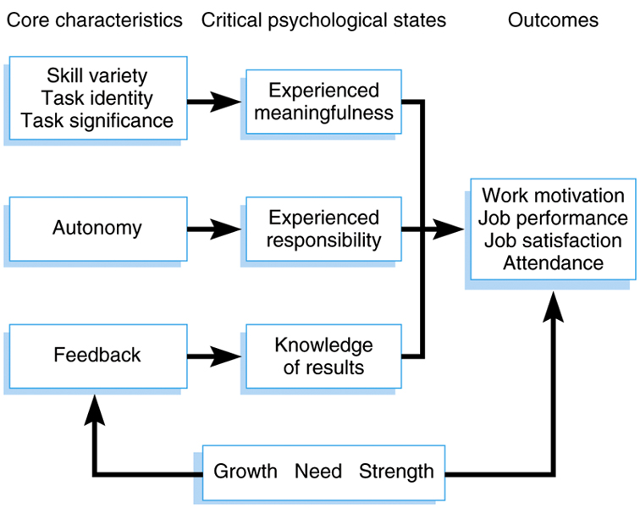
Job Characteristics Theory

Slide 25
Antecedents of Job Satisfaction: Environmental
Pay
Global satisfaction
Strongly relates to facet of pay satisfaction.
Fairness with which pay is distributed.
Equity is more important determinant of pay satisfaction than the actual pay.
Pay satisfaction is affected by comparison with the same job rather than comparison in general.
Considerable research has demonstrated positive relationship between pay and organizational performance.

Slide 26
Antecedents of Job Satisfaction: Environmental
Pay-Perceived Pay Equity
The perceived equity or fairness of ones pay can be more important than actual pay.
Survey Respondents has reported that if people with similar qualifications earn more than they did leads to dissatisfaction with their pay.
People who think that their salaries are higher than those of their colleagues are likely to be more satisfied with their pay.
It is subjective assumption with people developing personal standards of comparison.
Satisfaction with pay is determined by discrepancy between standard and actual salary.
Notes:
Women are paid less than males for same or similar kind of jobs

Slide 27
Antecedents of Job Satisfaction: Environmental
Pay - Merit Pay and Wage Incentive Pay Systems
Merit pay or pay for performance means that the better performing worker in organization are paid more than less productive workers.
Also relate to degree to which managers rely to their subordinates expertise and support.
Cross cultural differences have also cited in the effectiveness of merit pay. Researchers have found that merit pay is more effective motivator in poorer countries than in rich countries.
Wage incentive system are primary pay scheme where system provides incentive for higher job performance ( higher units produced).
Notes:
Women are paid less than males for same or similar kind of jobs

Slide 28
Antecedents of Job Satisfaction: Environmental
Justice
Perception of fairness are important determinants of peoples behaviors and reaction to work.
Distributive justice is the extent to which people perceive the allotment of work and rewards are fair.
Procedural justice is the extent people perceive that the process by which rewards at work are allocated to be fair.
The two forms have been linked to global and facet job satisfaction in Choen-Charash and Sepector (2001)Meta analysis.
Notes:
Women are paid less than males for same or similar kind of jobs

Slide 29
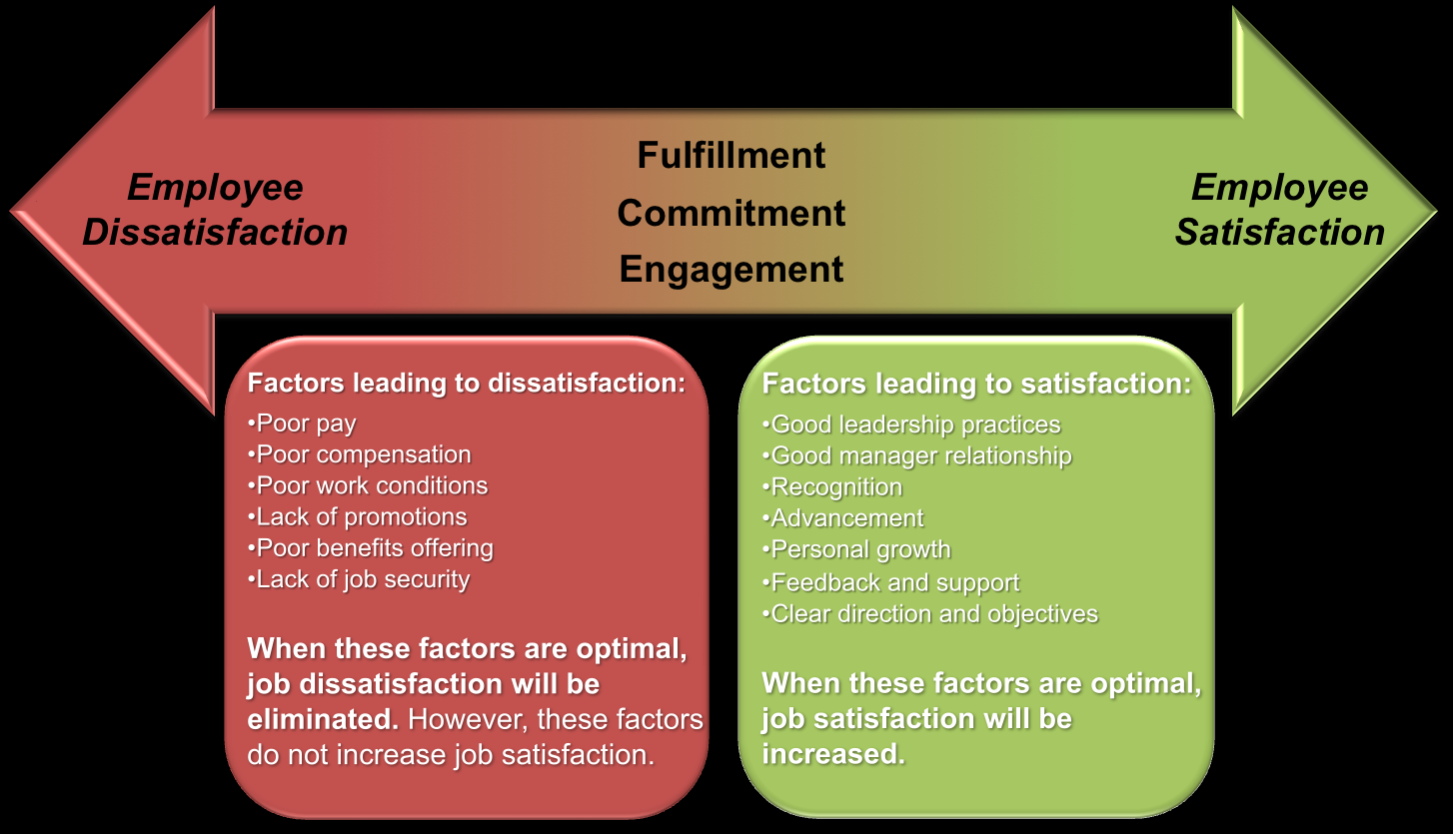

Slide 30
Antecedents of Job Satisfaction: Personal
Personality
Negative affectivity (high NAs less satisfied)
Locus of control (externals less satisfied)
Gender
Few gender differences
Age
Curvilinear—satisfaction lowest age 26 to 31
Culture and Ethnicity
Few racial differences within the U.S.
Western countries score higher than Asians
Could be due to response styles rather than true feelings

Slide 31
Antecedents of Job Satisfaction: Personal
Personality
Gender
Age
Culture/Race and Ethnicity
Cognitive Ability
Job Congruence
Use of Skills
Job control
Occupational Level

Slide 32
Antecedents of Job Satisfaction: Personal
Personality
Achievement striving : extent to which people work hard and take work seriously is positively related.
Negative affectivity(NA): Tendency for an individual to experience negative emotions such as anger, irritability anxiety and depression across wide variety of situations, viewing all aspects in negative way. High NAs less satisfied.( Chronic Kickers)
Happier and emotionally stable people show high level of job performance and earn high incomes.
Locus of control: It is the belief that people are in control of reinforcements in their life.
Internals: People who believe they control reinforcements.
Externals: people who believe that fate luck powerful others control reinforcements .
Internals are more satisfied than externals.

Slide 33
Antecedents of Job Satisfaction: Personal
Gender
Most studies have found fewer differences when they compared men and women in global job satisfaction.
It may not the gender rather group of factors that vary with gender like woman may be paid less than males for similar work and opportunities of promotion may be few.
Most women feel that they have to work harder and be more outstanding in their jobs to receive comparable rewards like men.
Such factors may influence job satisfaction.

Slide 34
Antecedents of Job Satisfaction: Personal
Age
Job satisfaction increases with age, lowest job satisfaction has been reported by youngsters.
Curvilinear—satisfaction lowest age 26 to 31
Young people may be disappointed with jobs as they face to find sufficient challenge and responsibility which tends to increase with age.
Older workers have greater opportunities to find fulfillment and self actualization on the job.
Job tenure may also be one factor higher the tenure higher the satisfaction.

Slide 35
Antecedents of Job Satisfaction: Personal
Culture/ Race and Ethnic
As work force countries like US are becoming increasing Multicultural several studies have been conducted to compare job satisfaction of various ethnic racial and cultural background feel about their jobs.
Few racial differences within the U.S.
Blacks have slightly lower satisfaction.
Western countries score higher than Asians
Could be due to response styles rather than true feelings

Slide 36
Antecedents of Job Satisfaction: Personal
Cognitive Ability
Though it does not appear to be significant determinant of job satisfaction but it may be important when related to the type of job a person chooses.
Person who are too intelligent for their work may find insufficient challenge and leading to boredom and dissatisfaction.
This factor is also related to education the more the person is educated higher the expectations from jobs and should be provided with greater opportunities if not leads to dissatisfaction.

Slide 37
Antecedents of Job Satisfaction: Personal
Job Congruence
Refers to the match between demands of job and abilities of employees.
Higher the congruence-The closer fit between skills and job requirements greater the job satisfaction.
Conversely poor fit between job demands and personal skills reduces potential job satisfaction
Use of Skills
A common complaint especially graduates in engineering and science is that their job does not allow them to exercise their skills and knowledge acquired in college training.
Survey of engineers show high dissatisfaction with job factors such as pay, working conditions nature of job.
People are happier at work if have chance to use their abilities.

Slide 38
Antecedents of Job Satisfaction: Personal
Job Control
People who can exercise greater control over their job duties will experience higher satisfaction.
A study on workers in Canada linked high job control to low level of stress and greater physical health .
Occupational Level
The higher the occupational status of the job greater the satisfaction.
Executives expressed more positive job attitudes than front supervisors who in turn will be more satisfied than front line workers.
High level jobs offer greater autonomy challenge and responsibility.
Job Category- Most satisfied entrepreneurs, technical professional and managerial.
- Least satisfied employees working in manufacturing, service industries and wholesale and retail businesses

Slide 39
Country Differences In Job Satisfaction Facets On JSS
Facet
Dominican Republic
Hong Kong
Jamaica
Singapore
US
Pay
17.2
15.0
5.8
14.0
11.8
Supervision
20.0
16.0
17.5
13.4
18.6
Fringe Benefits
16.8
14.4
6.1
14.2
14.3
Coworkers
20.0
15.6
17.0
13.4
17.9
Work Itself
22.2
14.9
18.3
17.1
18.9
Total
160.9
133.3
110.0
134.7
133.4

Slide 40
Antecedents of Job Satisfaction
Product of
Environment
Personality
Interaction of environment & personality
(Person job fit)
Environment
Job Satisfaction
Personality
Job Satisfaction
Environment
Job Satisfaction
Personality
Notes:
Job satisfaction is therefore is product of appropriately matching the individual to the job.

Slide 41
Person-Job Fit
Refers to the interaction of environmental and personal factors rater than treating them separately
States that job satisfaction will occur if there is match between individual and the job.
Correspondence between what people say they want in job and what they say they have.
Smaller the difference between wanting and having greater the job satisfaction.
Another job fit approach is people differ in reactions to same situation

Slide 42
Person-Job Fit
Verquer, Beehr and Wagner (2003) conducted a meta-analysis of 21 person-job fit studies and found that various measures of fit were correlated with job satisfaction.
Interaction of specific person and job variables in predicting job satisfaction.
Growth need strength(GNS) Hackman and Oldham’s(1976) theory
A person’s desire for satisfaction of higher order needs, autonomy and achievement.
Meta-analyses- It moderates the relation between job characteristics and job satisfaction. (Loher et al. 1985)
Correlation between these two variables greater individuals who are high in GNS.

Slide 43
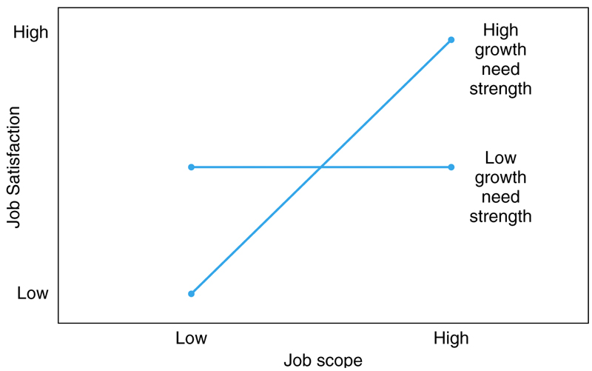
Moderating Effect of GNS On Relationship Between Job Scope and Job Satisfaction
Notes:
Skill variety, task autonomy, task significance, autonomy and task feedback

Slide 44
Job Characteristics Theory

Slide 45
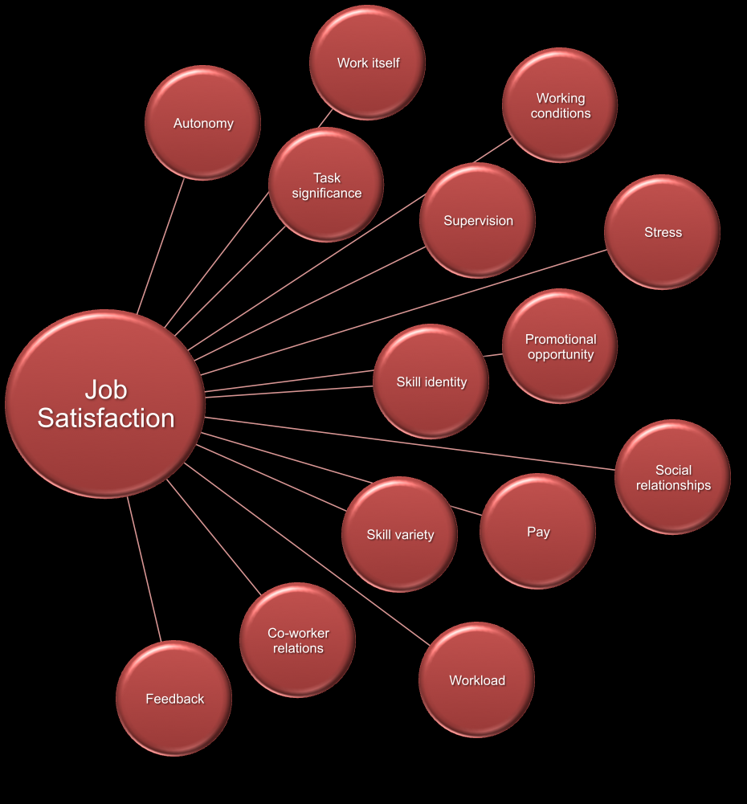

Slide 46
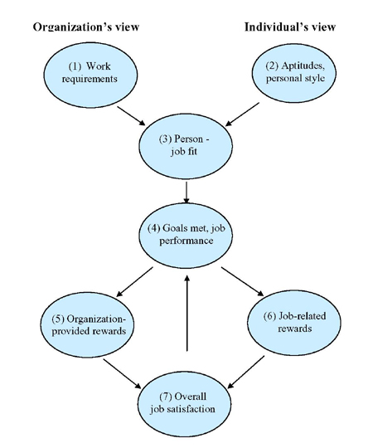
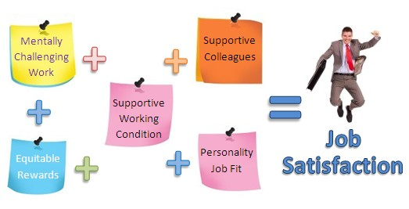

Slide 47
Effects of Job Satisfaction
Job Performance
Small correlation
More evidence that performance causes satisfaction than reverse
Turnover
Dissatisfied people more likely to quit
Moderated by labor market—people quit when they find another job
Absence
Very small correlation—other factors more important
Health and Well-Being
Job satisfaction relates to health variables such as anxiety and depression
Life Satisfaction
Job satisfaction important component of life satisfaction
Spillover

Slide 48
Effects of Job Satisfaction
Job Performance and Job satisfaction
Small correlation between two in various researches although it is clear that both two are related.
There are two possible explanations :
People who like their job perform better:
Performance might lead to Satisfaction:
More evidence that performance causes satisfaction than reverse: Rationale is employees who perform well will be more satisfied because they receive more rewards.
Job
Satisfaction
Efforts
Job
Performance
Job
Performance
Rewards
Job
Satisfaction

Slide 49
Effects of Job Dissatisfaction
Turnover or Quitting Jobs
Dissatisfied people more likely to quit
Moderated by labor market—people quit when they find another job.
Absence
People who dislike their work will be more likely avoid their work than people who like their jobs.
Very small correlation—other factors more important

Slide 50
Effects of Job Satisfaction
Health and Well-Being
Dissatisfied employees report more physical symptoms like sleep problems stomach upset than their satisfied counterpart.
Job dissatisfaction relates to negative emotional sates such as anxiety and depression
Life Satisfaction
Considers to be indicator of overall happiness or emotional well being. Job satisfaction important component of life satisfaction
Spillover: Satisfaction in one area spills over in other area
Compensation: Dissatisfaction in one area may be compensated for other.
Segmentation: People compartmentalize their life satisfaction in one area has no relation with other.

Slide 51
What is job satisfaction, Facets and overall approach
Cultural values : Individualism/collectivism, masculinity, power distance, uncertainty avoidance.
Assessment: JIG,MSQ.JDI
Antecedents of job satisfaction:
Environmental: Characteristics of job, pay, justice
Personal: Personality, gender, age, culture, cognitive ability
Person job fit approach and Growth needs index
Effects of job dissatisfaction
Turnover/quitting, absence, health and well being, life satisfaction

Slide 52
Organizational Commitment
Focus on Attachment of Individual to the organization.
Perspective:
Global Perspective : Based on work by Mowday, Steers, Porter (1979)
One commitment, three components
Acceptance of organization goals
Desire to stay with the organization
Willingness to work hard
Three component commitments perspective : Meyer and Allen& Smith (1993)
Affective: Like the job, emotional attachment, identifies with organization.
Continuance: Need the job, benefits, pension plans, salary, seniority.
Normative: Feel obligated to stay on the job, values of employee

Slide 53
Organizational Commitment
Job
Conditions
Affective
Commitment
Personal
Values
Met
Expectations
Normative
Commitment
Felt
Obligations
Benefits
Accured
Continuance
Commitment
Jobs
Available
Notes:
Affective commitment arises from favorable experiences in the job
Continuance is produced by investments in the job and difficulty finding another job.
Normative derived by sesnse of obligation either because of person values or from favors done for the person by the orgnisation.

Slide 54
Organizational Commitment- Assessment
Measured with self report scales like those used in job satisfaction.
Most Popular scale developed by Mowday (1979)which taps three aspects of commitment and combined they indicate global commitment.
Acceptance of organization goals
Intention to stay on the job
Willingness to work hard
Meyer(1993) developed scale which produces separate scores on three types of commitments.
Research by Hackett, Bycio and Hausdorf (1994)noted that Mowday scale mainly assess affective commitment but not with the continuance and normative subscales.

Slide 55
Organizational Commitment- Other Variables
Similar correlations as job satisfaction
High commitment associated with
High job scope
High job satisfaction
Low job stressors
Organisational Justice
Turnover is associated with commitment, those Low commitment would likely to switch more jobs than those with high commitment.
Meyer developed the idea of occupational commitment which concerns the occupation or profession rather than particular organization.

Slide 56
Emotions and Work The word emotion comes from a French term meaning “to stir up.
Job is important component of life not only providing necessities but also sense of purpose ,People react emotionally at workplace.
Emotion is defined as a short intense feeling resulting from some event
Emotion state: Immediate experience of a particular emotion
Emotion mood: How you have been feeling lately.
Emotions
“I was really angry when Prof. he criticized my presentation”
Identified with a source, cause
Tend to be brief, episodic
Many forms and types
Action oriented; link to behavior
Can turn into a mood
Moods
“Oh, I just don’t have the energy to do much today. I’ve felt down all week.”
Hard to identify cause
Can be long lasting
Either positive or negative
More cerebral; less action oriented
Can influence emotion
Notes:
Financial analysts measure the value of a company in terms of profits and stock. For employees, however, the value of a job is also emotional

Slide 57
Emotions and Work-
Causes and consequences
Not everyone reacts to the same situation in the same way.
Positive emotions such as joy, love, and surprise result from our reaction to desired events. They can be stimulated by positive atmosphere at work, rewards and nature of job.
Positive emotional state can make difficult challenges more achievable
Negative emotions such as anger fear sadness can result from undesired events. Things which are stressful and aversive at work can produce negative emotions. E.g. juggling conflicting demands, time pressure, work pressure unfair treatment.
Notes:
For example, a manager’s way of speaking can cause one person to feel motivated, another to feel angry, and a third to feel sad.
The unwanted side effects of negative emotions at work are easy to see: An angry colleague is left alone to work through the anger; a jealous colleague is excluded from office gossip, which is also the source of important office news.
ut you may be surprised to learn that negative emotions can help a company’s productivity in some cases. Anger at another company’s success, for example, can spark a burst of positive effort on behalf of a competitor. Jealousy about another division’s sales figures may inspire a rival division to work harder. While negative emotions can be destructive in the workplace, they can inspire bursts of valuable individual action to change situations that aren’t working the way they should.

Slide 58
Emotions and Work- Implications for Organization
Positive emotions: Feeling good
Greater creativity
Higher job satisfaction
More contextual performance(Volunteering to do extra work, need not associated with nature job )
Better job performance
Negative emotions: Feeling bad
Lower job satisfaction
Higher absence
More turnover
Emotions Linked with counterproductive work behaviour ( For e.g verbal aggression towards colleague, with holding information purposely)

Slide 59
Emotions and Work-
Emotional Contagion/ Spill over effect
Both positive and negative emotions can be contagious, with the spillover of negative emotions lasting longer than positive emotions
Research shows that some people are more susceptible to emotional contagion than others
Notes:
when the boss is happy, the staff is happy
Imagine you’re working behind the counter at a fast-food restaurant. Your mood is fine, until a customer argues with you about an order. You argue back. The customer leaves in a huff. Your anger emotions continue, turning into negative feelings that last throughout the day. As you might guess, you are more likely to make mistakes and find ordinary challenges annoying when you’re experiencing negative emotions. Unchecked, your negative emotions can spread to those around you. A negative interaction with one customer can spill over onto interactions with another customer

Slide 60
Emotional Labor
Emotional labour refers to the regulation of feelings and expression for organisational purposes
Required expression of certain behaviour at work is called emotional labour.
Three major levels of emotional labor have been identified.
Surface acting requires an individual to exhibit physical signs, such as smiling, that reflect emotions customers want to experience.
Deep acting takes surface acting one step further. This time, instead of faking an emotion that a customer may want to see, an employee will actively try to experience the emotion they are displaying. This genuine attempt at empathy helps align the emotions one is experiencing with the emotions one is displaying.
Genuine acting occurs when individuals are asked to display emotions that are aligned with their own. If a job requires genuine acting, less emotional labor is required because the actions are consistent with true feelings.
Emotional/cognative dissonance: Is a term that refers to a mismatch among emotions, attitudes, beliefs, and behavior, Expressing emotion you don’t feel
Notes:
A children’s hairdresser cutting the hair of a crying toddler may smile and act sympathetic without actually feeling so. In this case, the person is engaged in surface acting.
The children’s hairdresser may empathize with the toddler by imagining how stressful it must be for one so little to be constrained in a chair and be in an unfamiliar environment, and the hairdresser may genuinely begin to feel sad for the child.

Slide 61
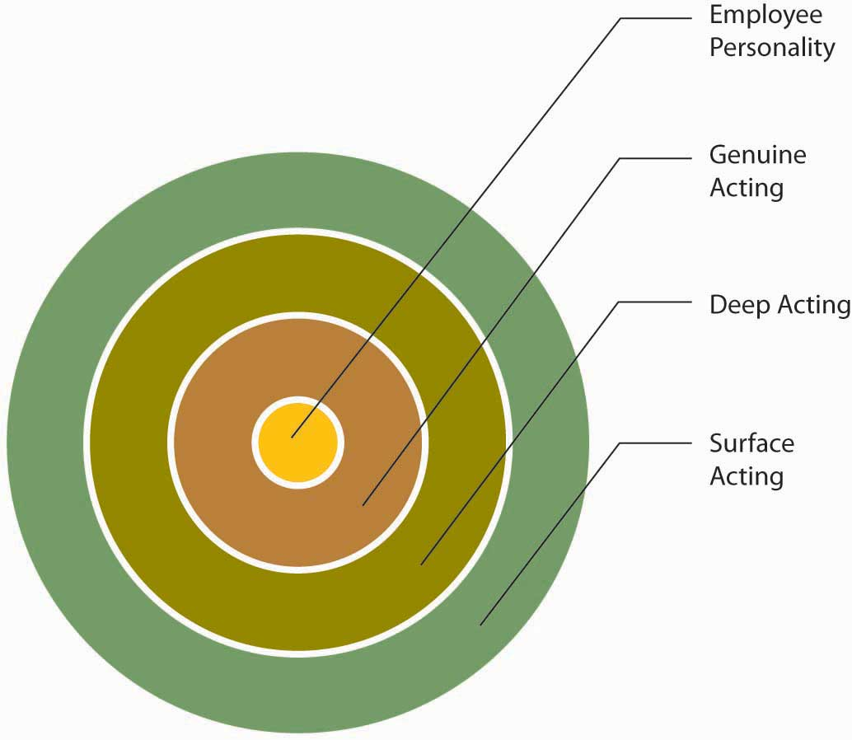
Emotional Labor
When it comes to acting, the closer to the middle of the circle that your actions are, the less emotional labor your job demands. The further away, the more emotional labor the job demands.
Research shows that surface acting is related to higher levels of stress and fewer felt positive emotions, while deep acting may lead to less stress

Slide 62
Emotions Affect Attitudes and behavior at work
Emotions shape an individual’s belief about the value of a job, a company, or a team.
Emotions also affect behaviors at work. Research shows that individuals within your own inner circle are better able to recognize and understand your emotions.
So, what is the connection between emotions, attitudes, and behaviors at work? This connection may be explained using a theory named Affective Events Theory (AET).

Slide 63
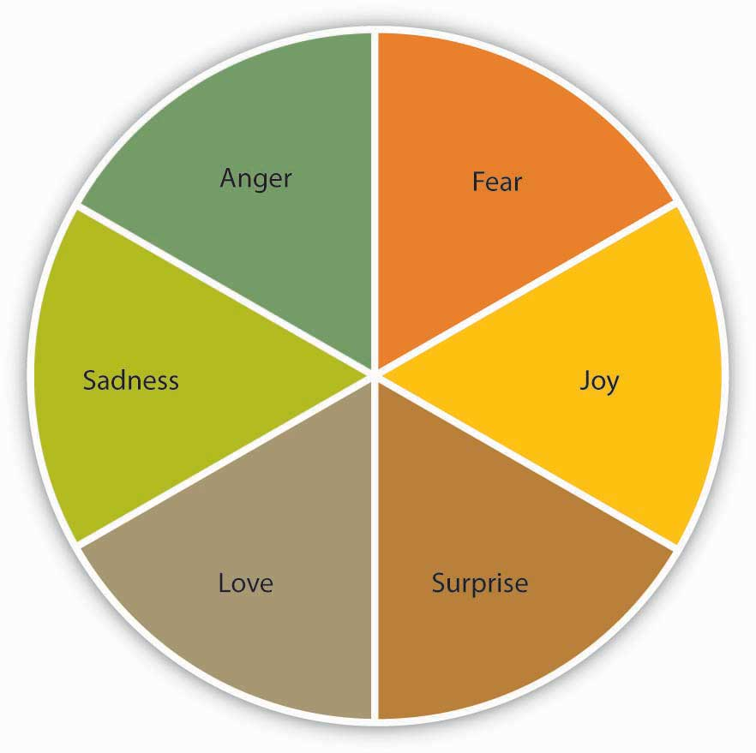
Affective Events Theory (AET)
Researchers Howard Weiss and Russell Cropanzano studied the effect of six major kinds of emotions in the workplace
Their theory argues that specific events on the job cause different kinds of people to feel different emotions.
Notes:
For example, imagine that a coworker unexpectedly delivers your morning coffee to your desk. As a result of this pleasant, if unexpected experience, you may feel happy and surprised. If that coworker is your boss, you might feel proud as well. Studies have found that the positive feelings resulting from work experience may inspire you to do something you hadn’t planned to do before. For instance, you might volunteer to help a colleague on a project you weren’t planning to work on before. Your action would be an affect-driven behavior
Alternatively, if you were unfairly reprimanded by your manager, the negative emotions you experience may cause you to withdraw from work or to act mean toward a coworker

Slide 64
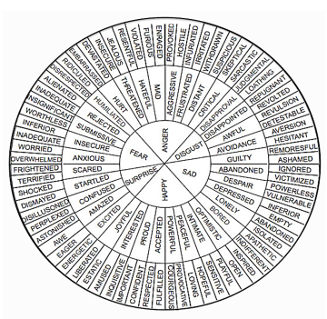

Slide 65
Affective Events Theory (AET)
Over time, these tiny moments of emotion on the job can influence a person’s job satisfaction..
Job satisfaction in the AET model comes from the inside-in—from the combination of an individual’s personality, small emotional experiences at work over time, beliefs, and affect-driven behaviors.
Jobs that are high in negative emotion can lead to frustration and burnout—an ongoing negative emotional state resulting from dissatisfaction
Notes:
Although company perks and promotions can contribute to a person’s happiness at work, satisfaction is not simply a result of this kind of “outside-in” reward system

Slide 66
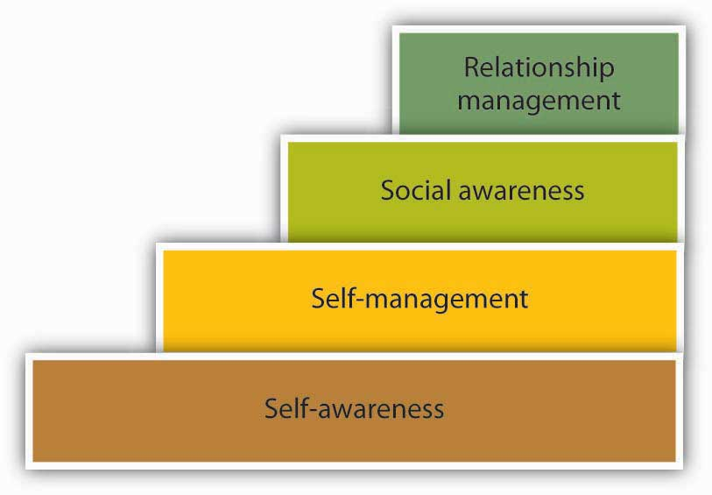
Emotional Intelligence
Emotional intelligence looks at how people can understand each other more completely by developing an increased awareness of their own and others’ emotions.
There are four building blocks involved in developing a high level of emotional intelligence.
Notes:
exists when you are able to accurately perceive, evaluate, and display appropriate emotions. Self-management exists when you are able to direct your emotions in a positive way when needed. Social awareness exists when you are able to understand how others feel. Relationship management exists when you are able to help others manage their own emotions and truly establish supportive relationships with others

Slide 67
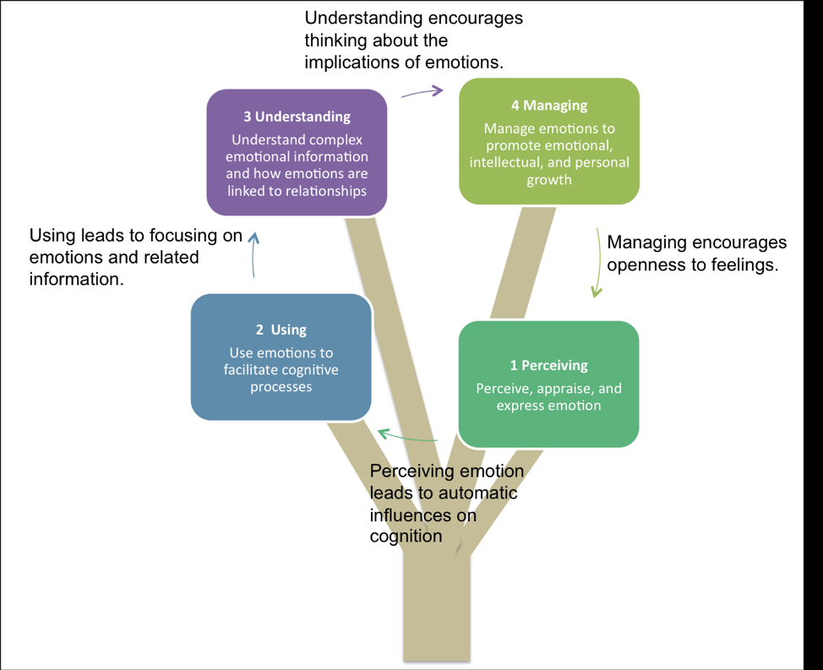

Slide 68
Why is Developing EQ Important in the Workplace?
Emotional intelligence is a vital consideration in the workplace for many reasons, but there are two that really stick out:
It is linked to higher job satisfaction for those with high EI/EQ as well as employees who work with or are managed by those with high EI/EQ.
It is strongly associated with job performance.

Slide 69
How Can You Be Happier at Work
Have a positive attitude about it. Your personality is a big part of your happiness. If you are always looking for the negative side of everything, you will find it.
A good fit with the job and company is important to your happiness. This starts with knowing yourself: What do you want from the job? What do you enjoy doing? Be honest with yourself and do a self-assessment.
Get accurate information about the job and the company. Ask detailed questions about what life is like in this company. Do your resarch: Read about the company, and use your social network to understand the company’s culture.
Develop good relationships at work. Make friends. Try to get a mentor. Approach a person you admire and attempt to build a relationship with this person. An experienced mentor can be a great help in navigating life at a company. Your social network can help you weather the bad days and provide you emotional and instrumental support during your time at the company as well as afterward.

Slide 70
How Can You Be Happier at Work
Pay is important, but job characteristics matter more to your job satisfaction. Don’t sacrifice the job itself for a little bit more money. When choosing a job, look at the level of challenge, and the potential of the job to make you engaged.
Be proactive in managing organizational life. If the job is stressful, cope with it by effective time management and having a good social network, as well as being proactive in getting to the source of stress. If you don’t have enough direction, ask for it!
Know when to leave. If the job makes you unhappy over an extended period of time and there is little hope of solving the problems, it may be time to look elsewhere.

Slide 71
Being Mindful of What You are Feeling
Sometimes it's hard to put a finger on the term to describe how we are feeling. A high level descriptor such as "happy" or "sad" is likely to come to mind first. Yet if you dig a little deeper you might uncover more accurate feelings and emotions that better describe your current mood or behavior.
Why would you want to do that?
Several reasons actually.
One is because being mindful of what you are really feeling can help you identify possible reasons why.
Two, you can shift your thinking from "I am Sad" to "I am feeling sad...because more deeply I feel (example: ashamed, fragile, remorseful)
Three with this deeper understanding of your emotions you can begin to shift and re-frame your thinking or move through emotions naturally.

Slide 72
Assignment – Case study
A person’s behavior and satisfaction toward work can be affected by a combination of personality traits, level of loyalty to one’s organization, level of immersion into one’s work and dedication to one’s profession.
Discuss how this statement holds true following this case study and prepare an assignment based on case

Slide 73
Assignment case study of Rahul
It should be typed in 12 New times Roman
First page should contain:
Name of the topic
Your name:
UID
Assignment no:
Date of submission

Slide 74
Emotional Intelligence
One ted talk video : https://youtu.be/h-rRgpPbR5w
EQ test
Explanation of emotional intelligence

